Slide 1
Introduction to
Java Web Application
By
ณรงค์ จันทร์สร้อย
IBM Rational Certified Consultant on OOAD
Sun Certified Enterprise Architect for J2EE Technology

Slide 2
Table of Contents
Introduction to Servlets
Servlet Lifecycle
Servlet APIs
Session Tracking Overview
Servlet Filter Framework
Introduction to Java ServerPages
Usage Models of JSPs
JSP Scripting Elements
Application and Session Scope
Session, Request and Page Scope
JSP Standard Tags
What is JavaBeans?
Exchanging Objects between Servlet and JSP

Slide 3
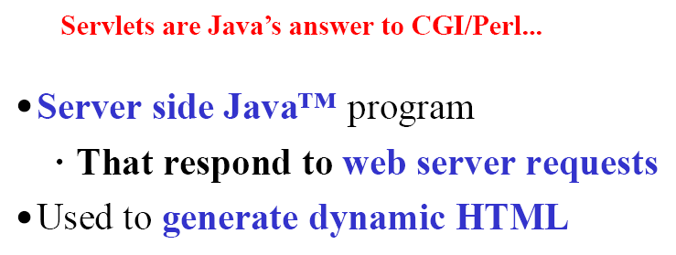
What is Servlets?

Slide 4
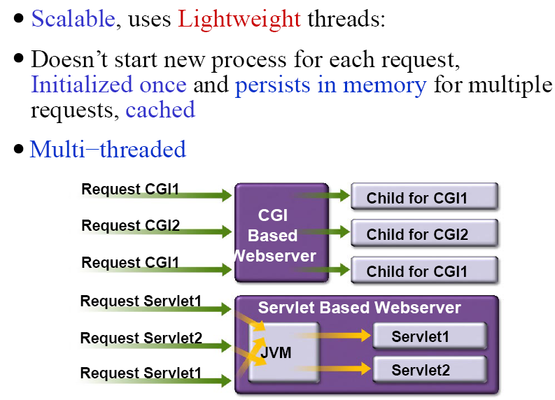
Servlets vs. CGI

Slide 5
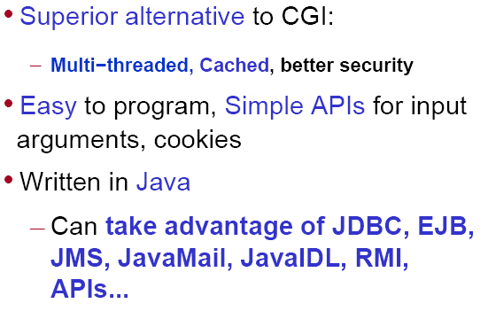
Why Servlets

Slide 6
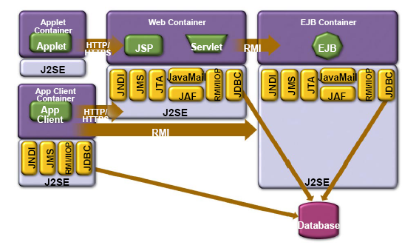
Servlet and JSP Run in Web Container

Slide 7
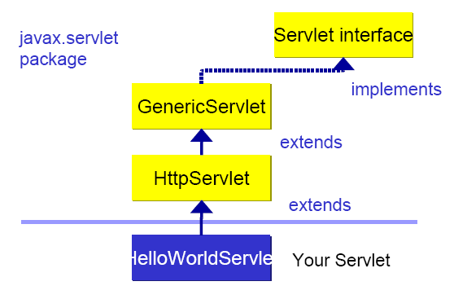
Servlet APIs

Slide 8
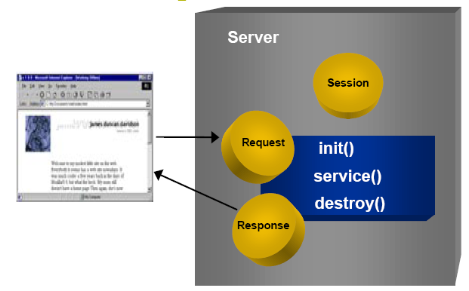
Servlet Example

Slide 9
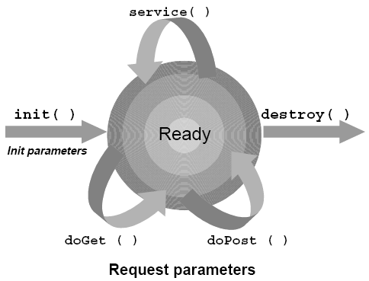
Servlet Lifecycle

Slide 10
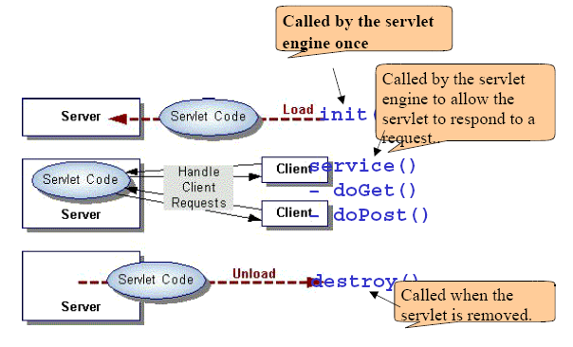
Servlet Lifecycle

Slide 11
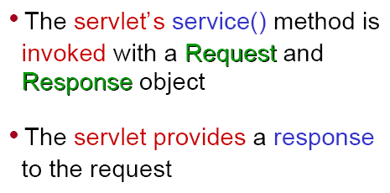
Anatomy of a Request

Slide 12
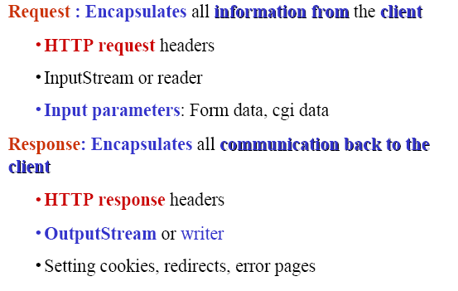
Request and Response Parameters

Slide 13
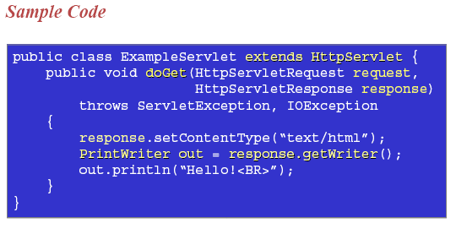
A Simple Servlet

Slide 14
Retrieving HTTP Parameter
HttpServletRequest.getParameter(paramName)
Example:
Email email = request.getParameter(“email");

Slide 15
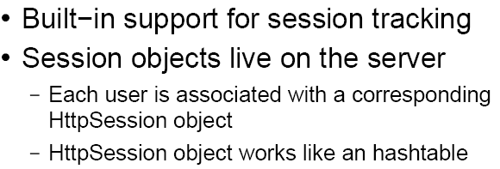
Session Tracking Overview

Slide 16
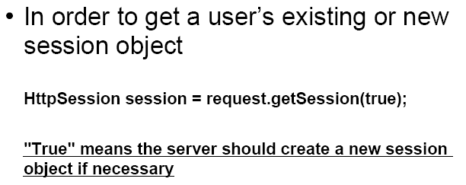
Getting Hold of a Session

Slide 17
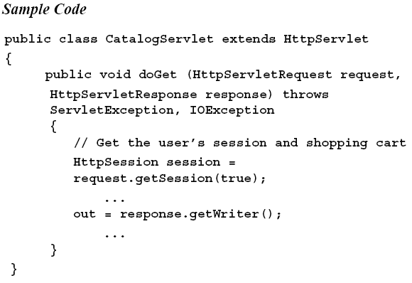
Getting Hold of a Session

Slide 18
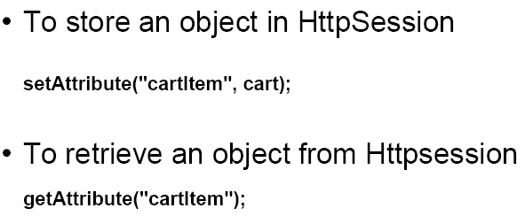
Storing and Retrieving Session Data

Slide 19
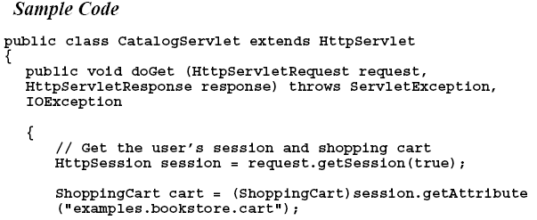
Storing and Retrieving Session Data

Slide 20
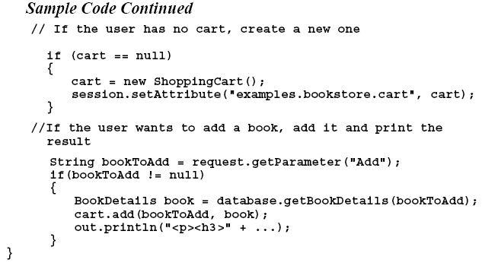
Storing and Retrieving Session Data

Slide 21
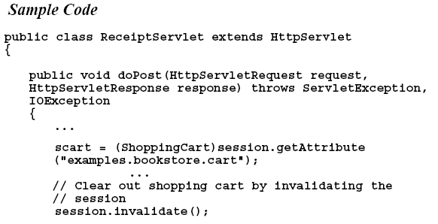
Invalidating the Session

Slide 22
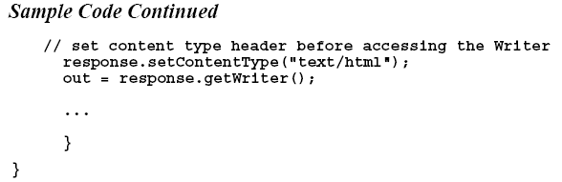
Invalidating the Session

Slide 23
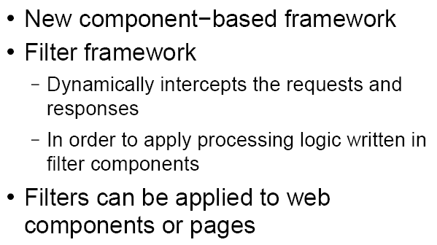
Servlet Filter Framework

Slide 24
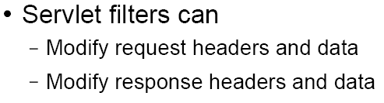
Servlet Filter Framework

Slide 25
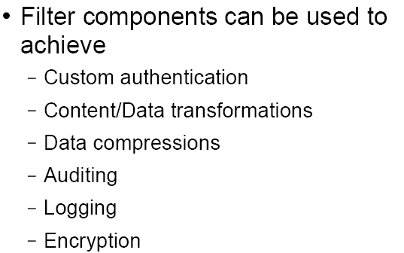
Applications of Filters

Slide 26
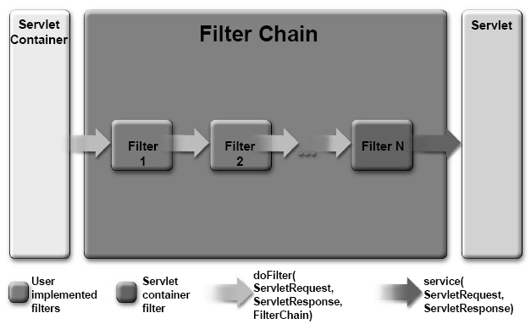
How Does a Servlet Filter Work?

Slide 27
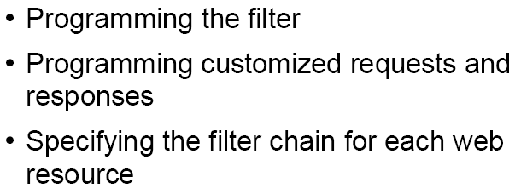
Steps involved in Writing Filters

Slide 28
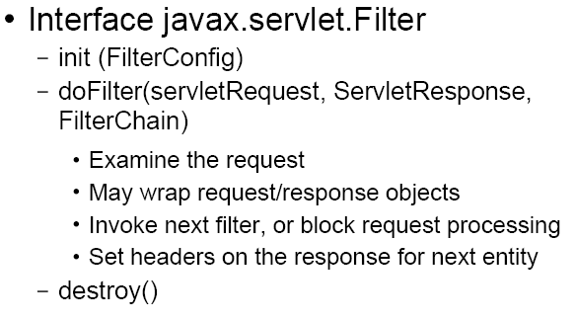
Servlet Filters API

Slide 29
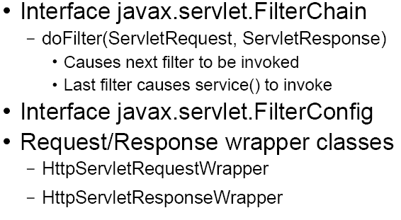
Servlet Filters API

Slide 30
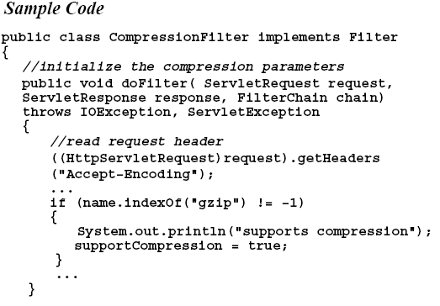
Sample Filter

Slide 31
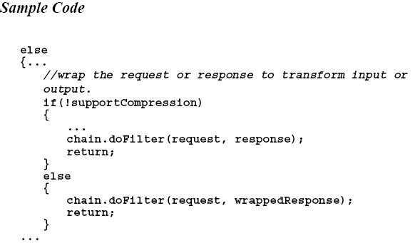
Sample Filter

Slide 32
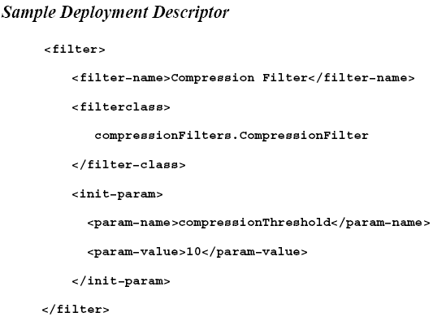
Filter Configuration

Slide 33
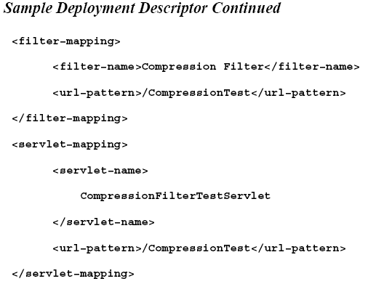
Filter Configuration

Slide 34
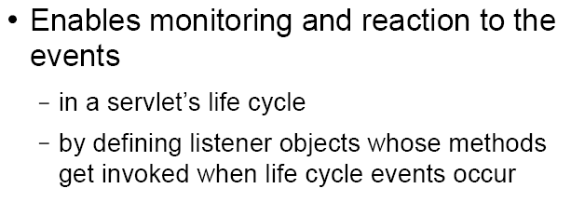
Servlet Lifecycle Events Framework

Slide 35
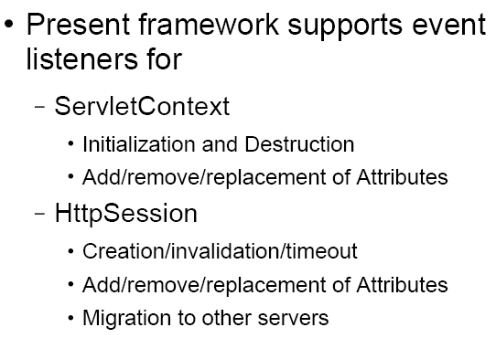
Framework Support for Events

Slide 36
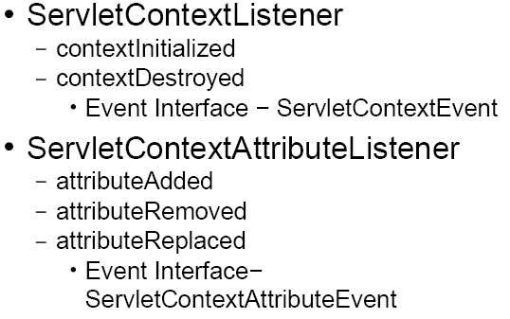
ServletContext Listener APIs

Slide 37
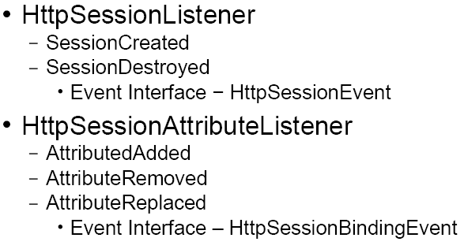
HttpSession Listener APIs

Slide 38
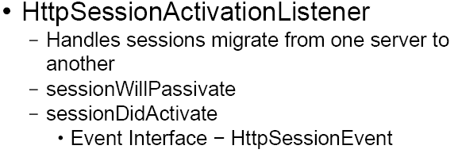
HttpSession Listener APIs

Slide 39
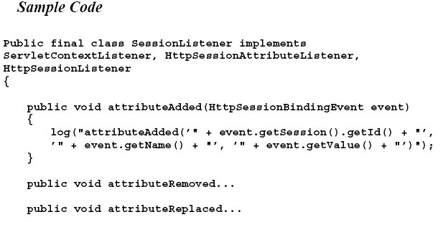
Sample Session Listener

Slide 40
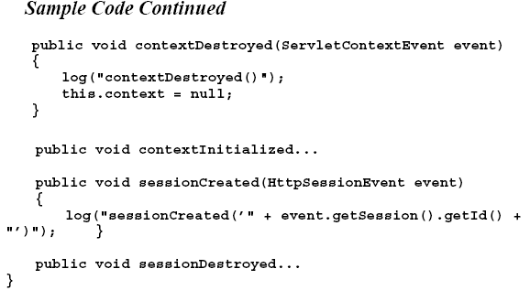
Sample Session Listener

Slide 41
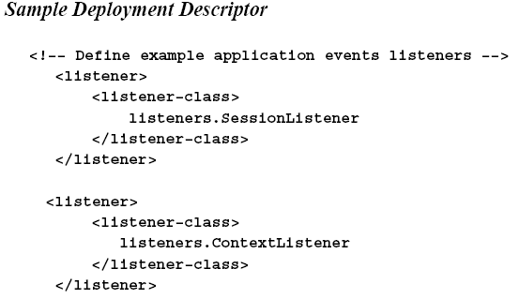
Listener Configuration

Slide 42
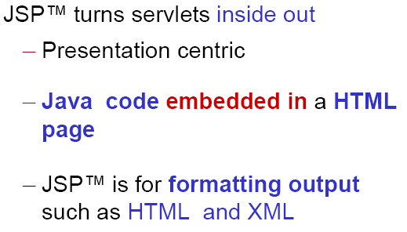
What is Java ServerPages?

Slide 43
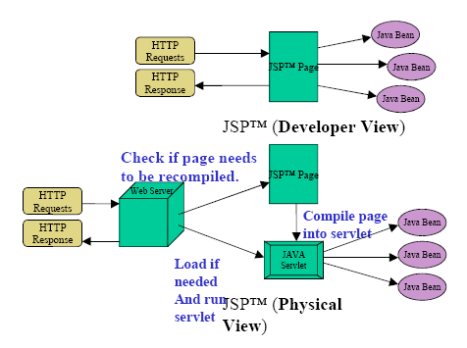
HTML to JavaBeans Mapping

Slide 44
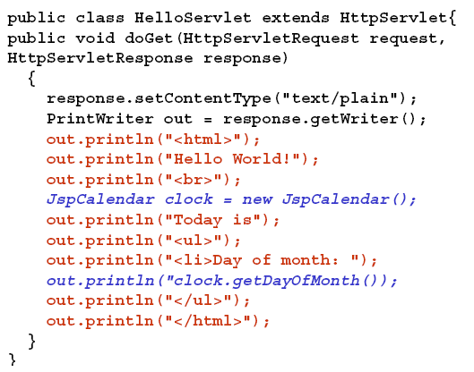
Example Servlet

Slide 45
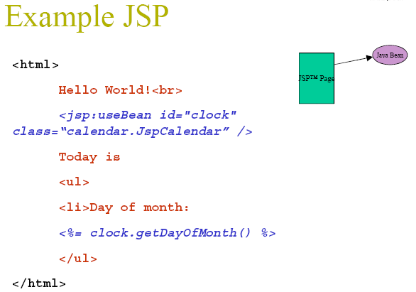
Example JSP

Slide 46
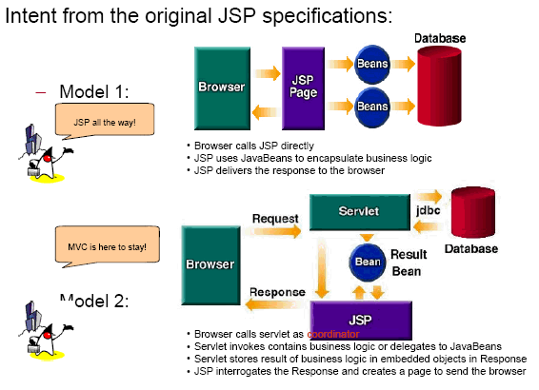
Usage Models of JSPs

Slide 47
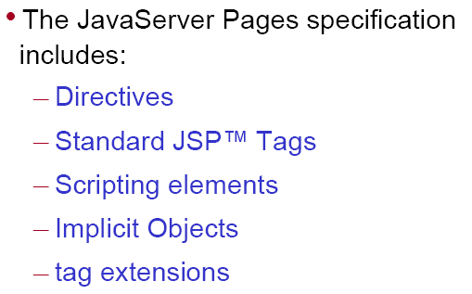
JSP Syntax Basics

Slide 48
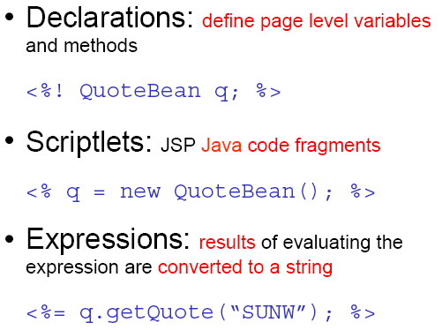
JSP Scripting Elements

Slide 49

Directives

Slide 50
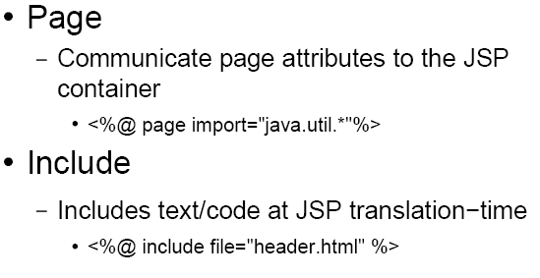
Important Directives

Slide 51
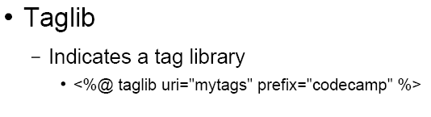
Important Directives

Slide 52
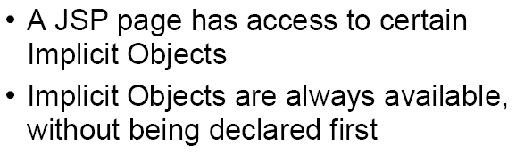
Implicit Objects

Slide 53
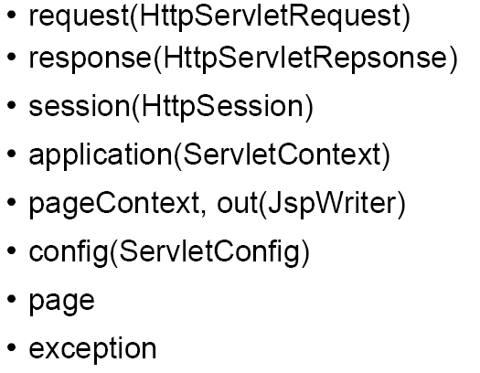
Implicit Objects

Slide 54
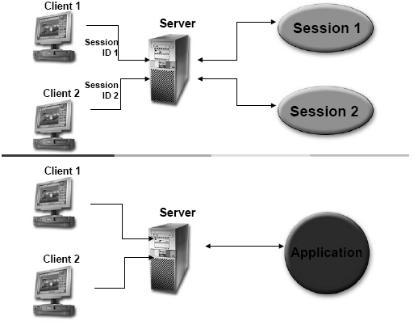
Application and Session Scope

Slide 55

Session, Request and Page Scope

Slide 56

JSP Standard Actions

Slide 57

Example of JSP Standard Actions

Slide 58

What is a JavaBeans?

Slide 59

Sample JavaBeans?

Slide 60

JSP Standard Tags

Slide 61

JSP Standard Tags

Slide 62

JSP Sample

Slide 63

Portable Tag Extension Mechanism

Slide 64

Exchanging Objects between Servlet and JSP

Slide 65
The Model-View-Controller (‘MVC’) Design pattern
The MVC architecture divides applications into three layers--model, view, and controller and decouples their respective responsibilities.
Model
Responsible for the business domain state knowledge.
View
Responsible for a presentation view of the business domain.
Controller
Responsible for controlling the flow and state of the user input.
Notes:
Each layer handles specific tasks and has specific responsibilities to the other areas.

Slide 66

The Model-View-Controller Architecture

